Slide 1
Powerhouse Park Trail Plan
Peter Dolan
Trail Program Manager
New York-New Jersey Trail Conference

Slide 2
This Presentation
Notes:
Welcome Maintenance 101
Introduce self and assistant

Slide 3
This Presentation
15 minutes to cover:
About the Trail Conference
Scope of Work
Plan Document
Bridge Recommendations
GIS Map
Park Connectivity
Additional Resources
Questions

Slide 4
About the Trail Conference
Notes:
Welcome Maintenance 101
Introduce self and assistant

Slide 5
New York-New Jersey Trail Conference
Nonprofit organization committed to:
Developing, building, and maintaining trails since 1920.
Protecting trail lands through support and advocacy.
Educating the public in the responsible use of trails and the natural environment.
Supporting land managers through trail planning and assessment.

Slide 6
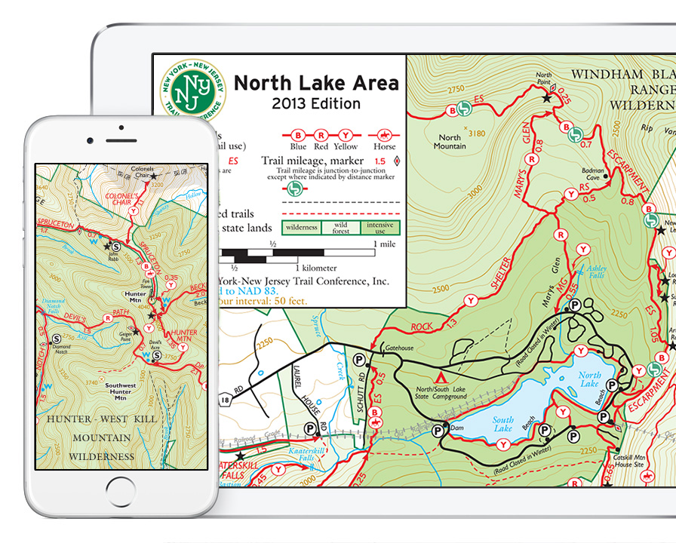
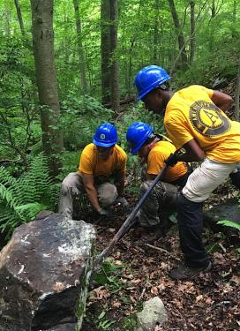
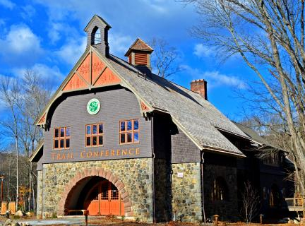
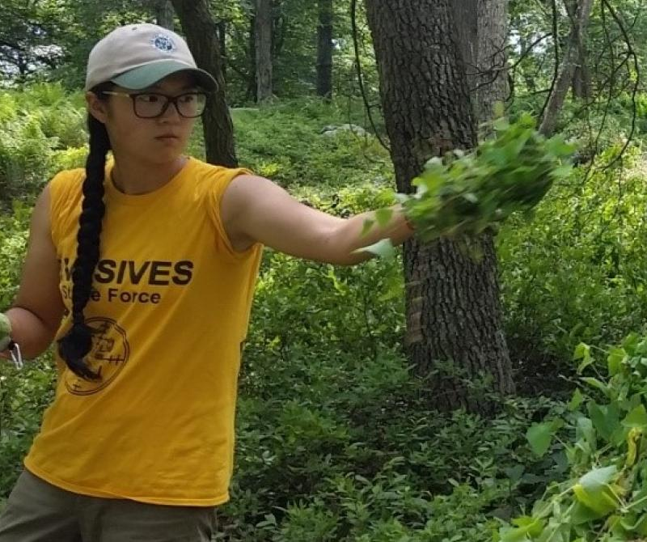
Notes:
Explain everything from layout and blazing to stone work and bridge building

Slide 7
About Me:
Grew up hiking trails around nearby Greenwood Lake.
Joined Trail Conference staff in 2013, seven years coordinating the NJ trail program.
Appointed Trail Program Manager in 2020, currently oversee entire trail program across 2,150+ miles of trail.
Specialize in trail planning initiatives, with most recent project being recommendations covering 215 miles of trail in Harriman and Bear Mountain State Parks.

Slide 8
Scope of Work
Notes:
Welcome Maintenance 101
Introduce self and assistant

Slide 9
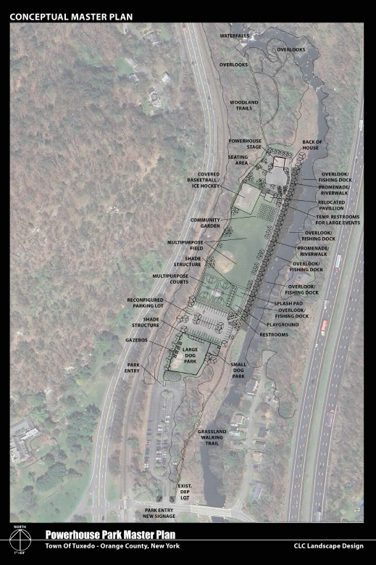
Powerhouse Park Trail
Trail Conference will conduct practical on-the-ground scouting to confirm feasibility and produce implementation guidance for the trail route proposed in the Park Master Plan (right).
Planning work and documentation will be coordinated with the project’s Landscape Architect to produce a cohesive overall vision and conceptual mockups.
Goal will be to produce GPS tracks, on-the-ground flagging, and a trail guidance document that can be used to move from concept and planning to physical construction.

Slide 10
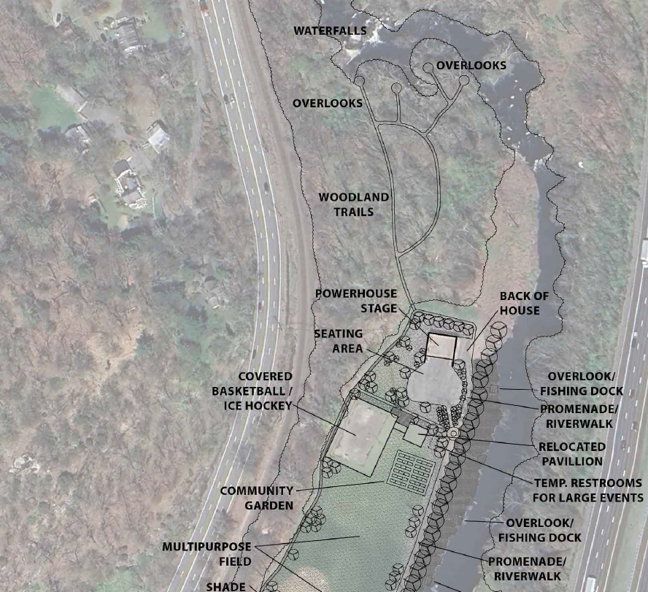
N

Slide 11
N

Slide 12
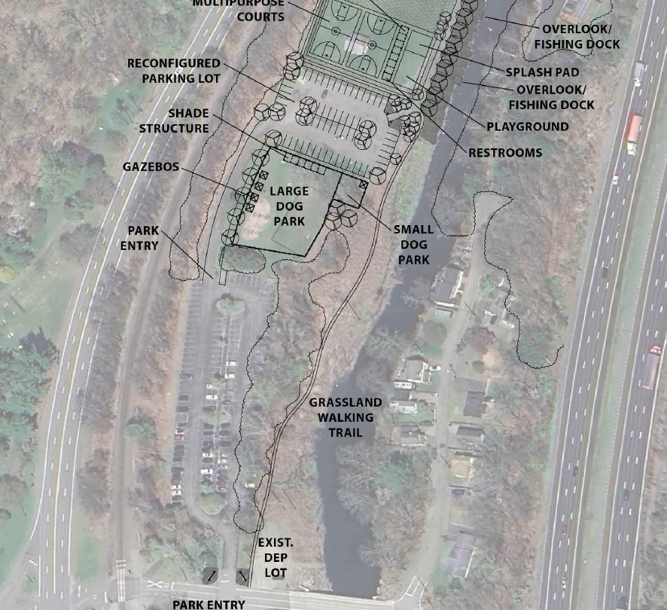
S

Slide 13
S

Slide 14
Plan Document
Notes:
Welcome Maintenance 101
Introduce self and assistant

Slide 17
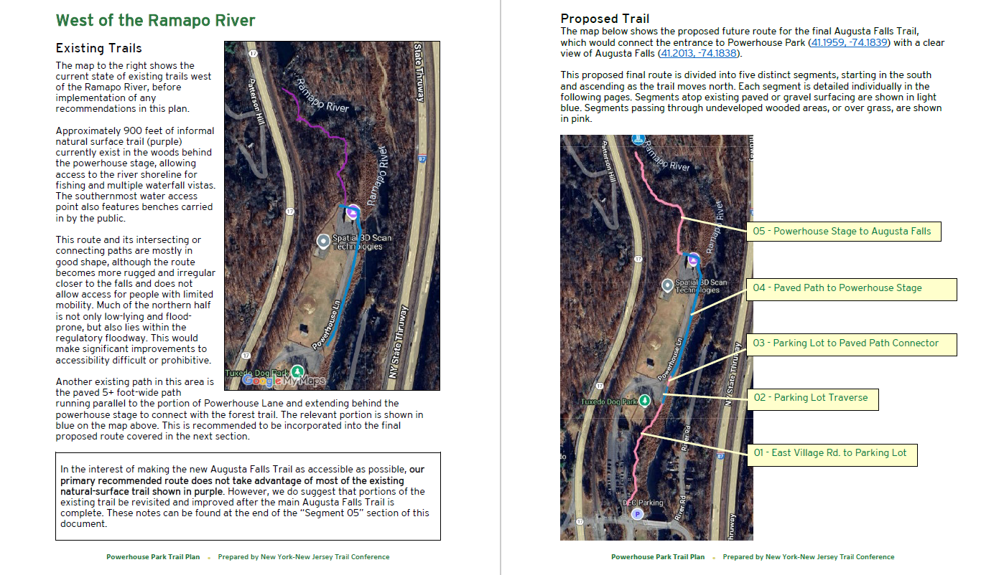

Slide 18
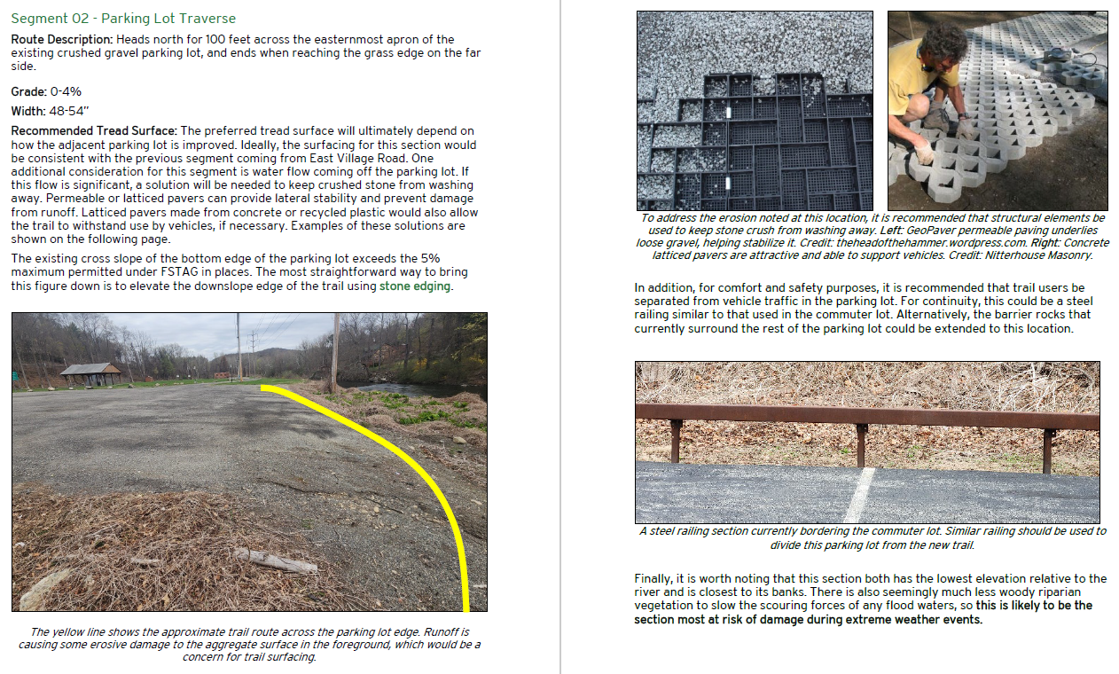

Slide 21
Bridge Recommendations
Notes:
Welcome Maintenance 101
Introduce self and assistant

Slide 25
GIS Map
Notes:
Welcome Maintenance 101
Introduce self and assistant

Slide 26
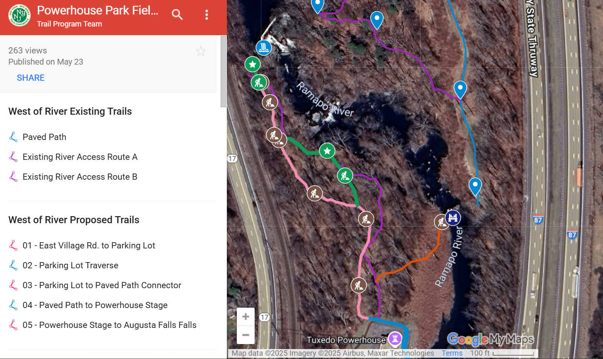

Slide 27
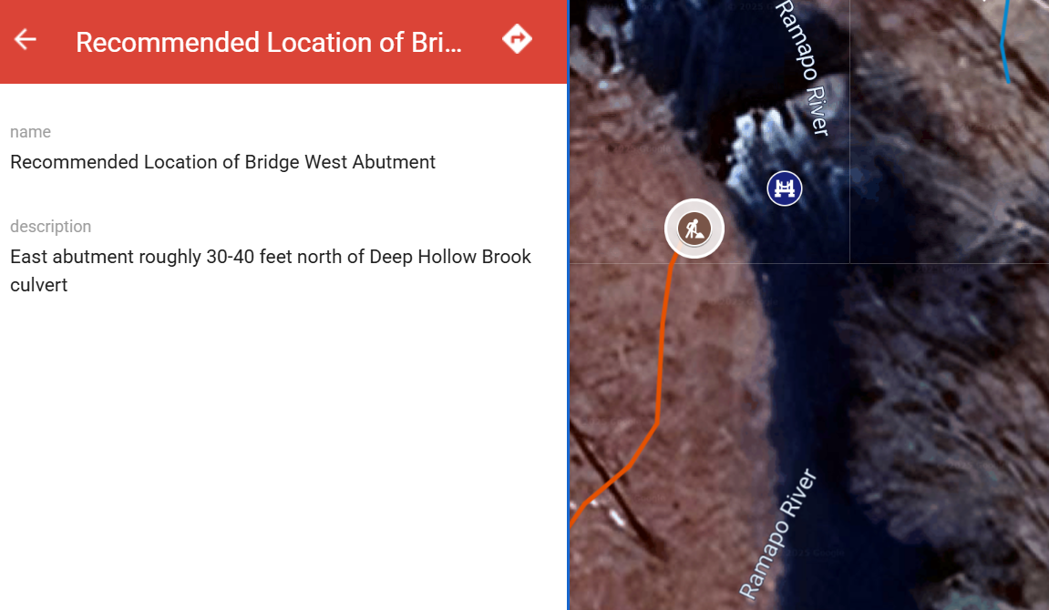

Slide 28
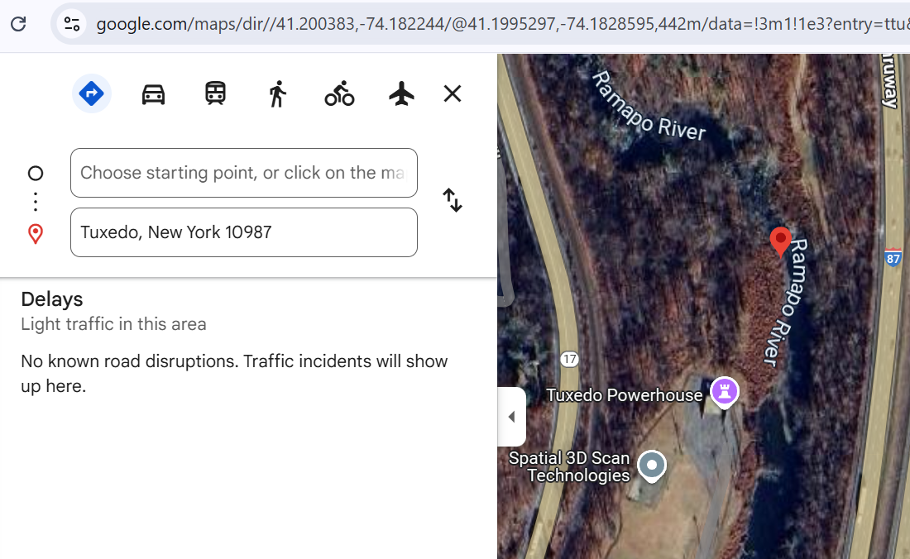

Slide 29
Park Connectivity
Notes:
Welcome Maintenance 101
Introduce self and assistant

Slide 31
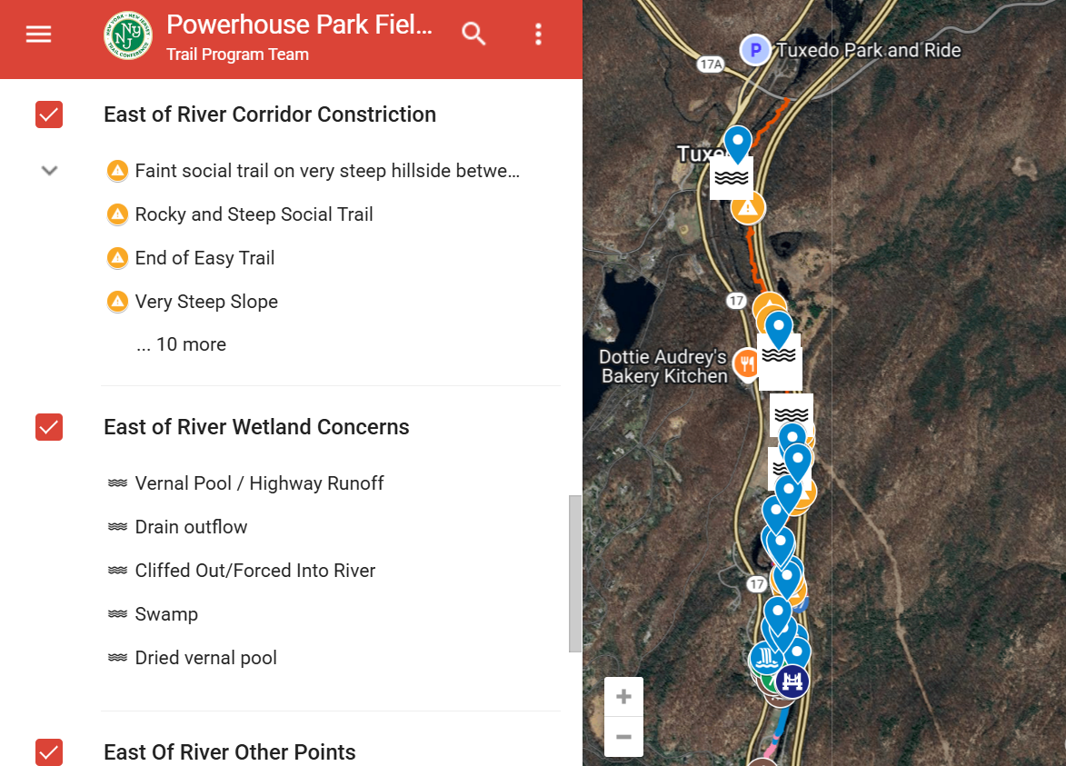

Slide 32
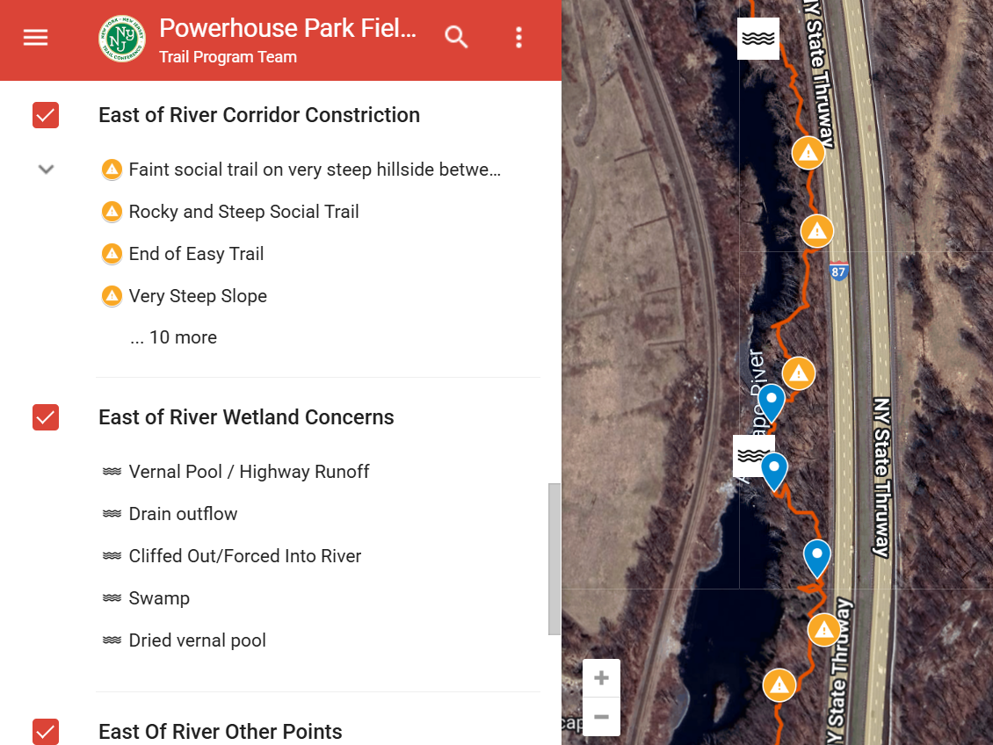

Slide 33
Additional Resources
Notes:
Welcome Maintenance 101
Introduce self and assistant

Slide 34
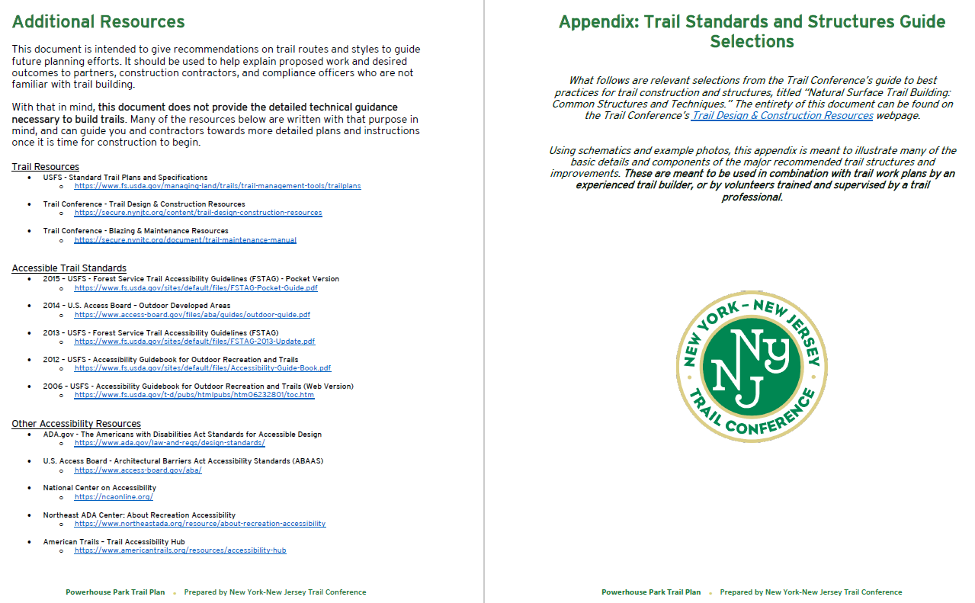

Slide 35
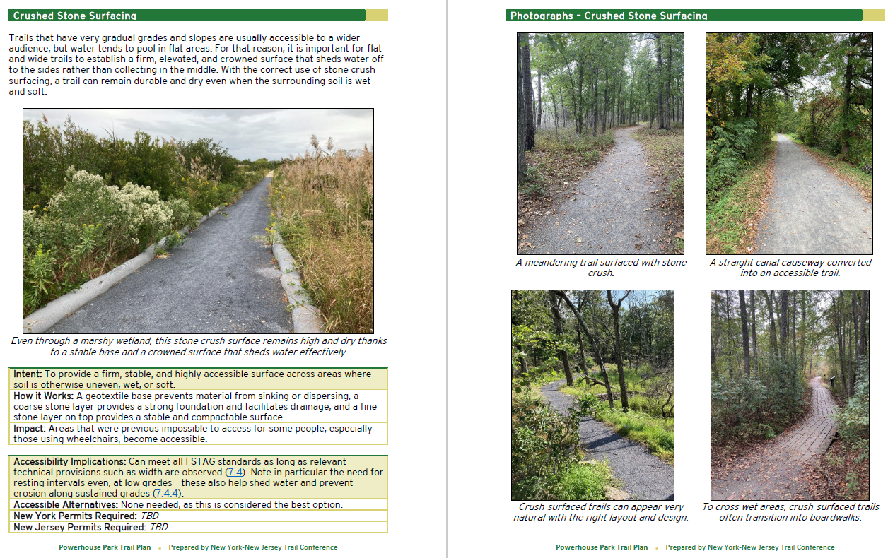

Slide 36
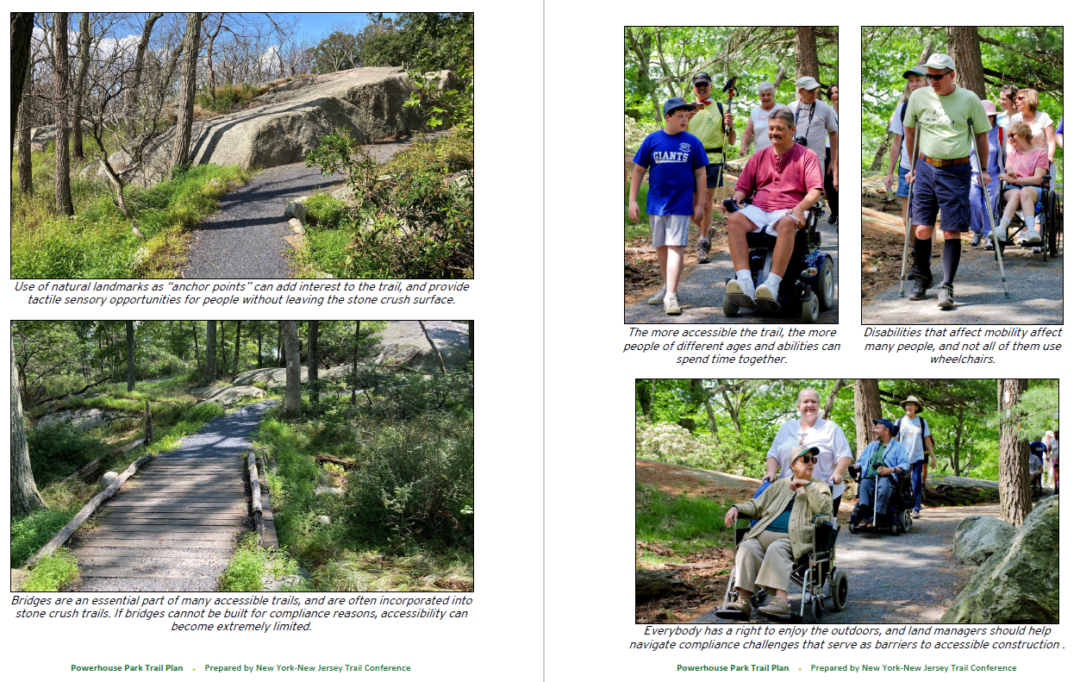

Slide 37
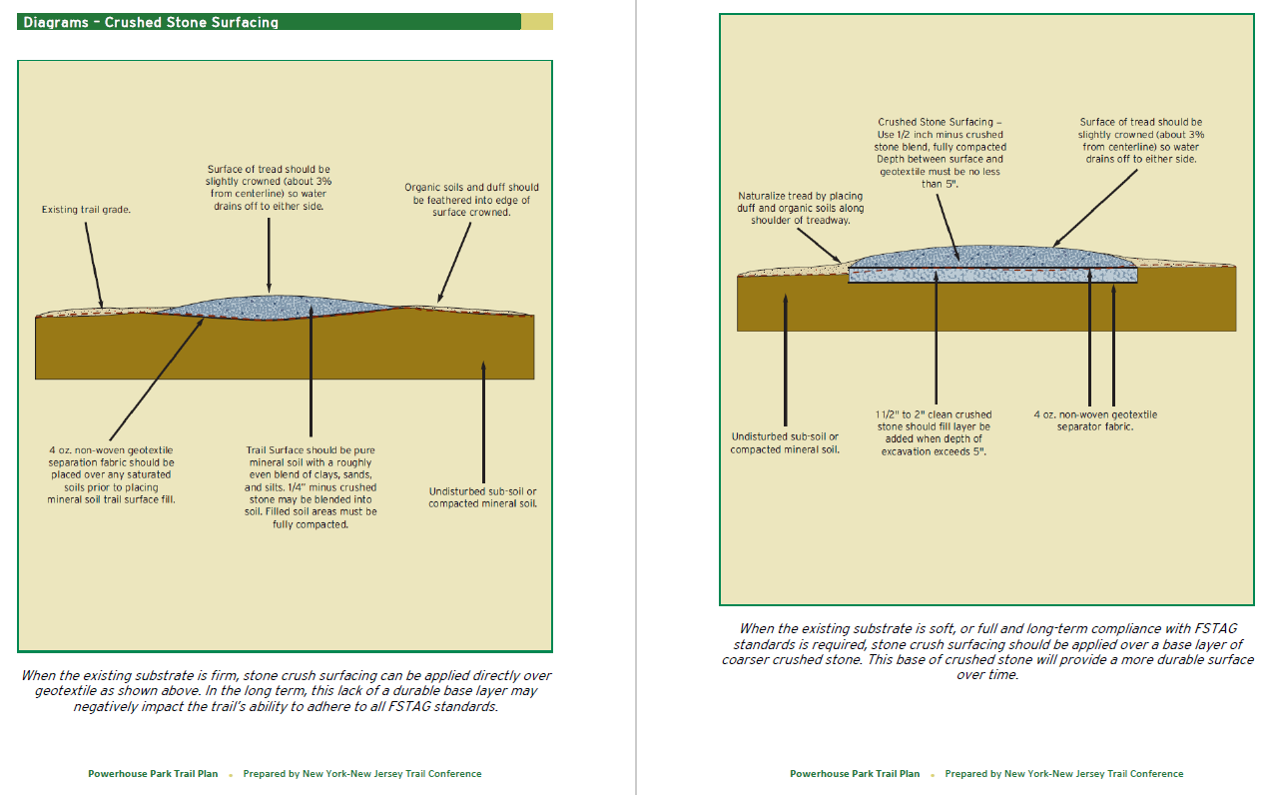

Slide 38
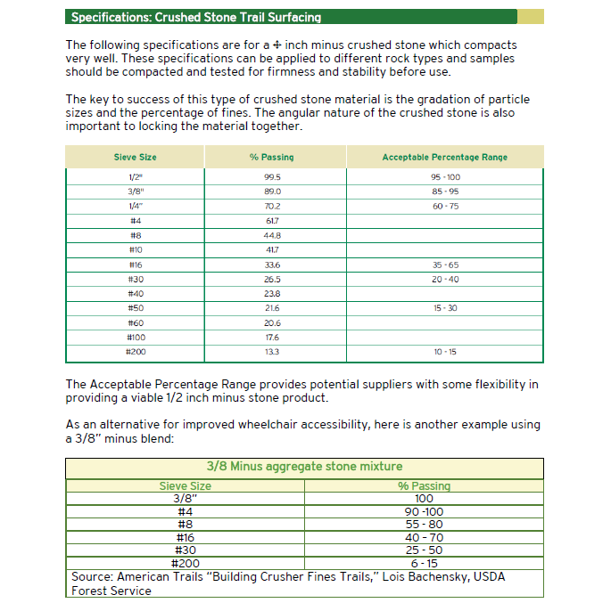

Slide 39
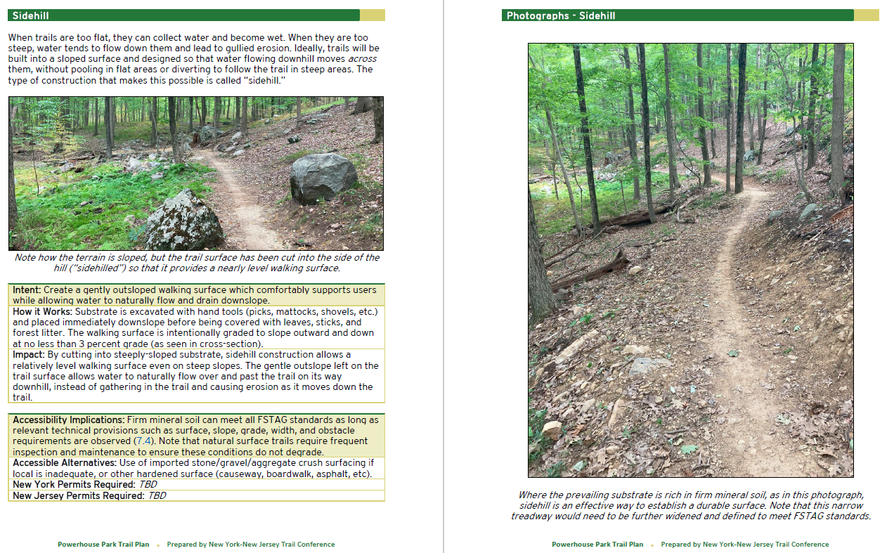

Slide 40
Questions?
Notes:
Welcome Maintenance 101
Introduce self and assistant

